Slide 1

THE FUTURE IS HERE
Revolutionizing Healthcare

Slide 2
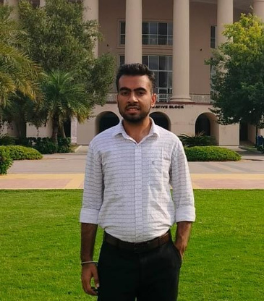

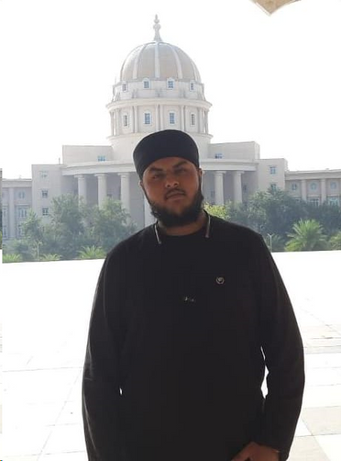

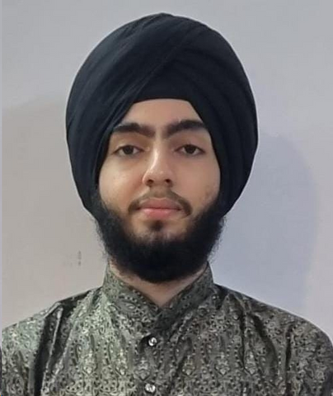
MEET THE TEAM
Aryan Bains
Prabhdeep Singh
Narula
Sneha Singh
Divnit Singh
Dhodi

Slide 3
OUR PROJECT ENVISIONS A HARMONIOUS INTEGRATION OF ADVANCED TECHNOLOGIES TO REDEFINE THE HEALTHCARE EXPERIENCE.
DRONES, AI, IOT, BLOCKCHAIN - ALL CONVERGING TO REVOLUTIONIZE THE WAY WE APPROACH HEALTH AND WELL-BEING.
KEY FEATURES
SEAMLESSLY CONNECTING PATIENTS, HEALTHCARE PROVIDERS, AND ESSENTIAL medical services.
BREAKING BARRIERS TO PROVIDE EFFICIENT AND ACCESSIBLE HEALTHCARE SOLUTIONS.

Slide 4

Accessibility across different devices, allowing doctors to make informed decisions regardless of their location.
Patient records, prescriptions, and pertinent data stored in one location, streamlining accessibility for authorized users.
Electronic Health Record
A secure platform for doctors to update prescriptions, share test results, and discuss patient care plans.
Informed patients can actively participate in their healthcare decisions, fostering a collaborative approach.

Slide 5


AI ChatBot
OUR AI-POWERED CHATBOT IS YOUR VIRTUAL GUIDE, SEAMLESSLY BLENDING TECHNOLOGY WITH PERSONALIZED PATIENT CARE.
EXPERIENCE HEALTHCARE ON DEMAND WITH OUR CHATBOT, PROVIDING INSTANT ACCESS TO INFORMATION AND ASSISTANCE ANYTIME, ANYWHERE.
DESIGNED FOR EASE, OUR CHATBOT ASSISTS IN NAVIGATING EHR, SCHEDULING APPOINTMENTS, AND SWIFTLY RETRIEVING MEDICAL INFORMATION, ENSURING A SEAMLESS USER EXPERIENCE.
WITH THE POWER OF AI, OUR CHATBOT LEARNS AND TAILORS INTERACTIONS TO USER PREFERENCES, OFFERING A PERSONALIZED AND EFFICIENT HEALTHCARE ENGAGEMENT.

Slide 6
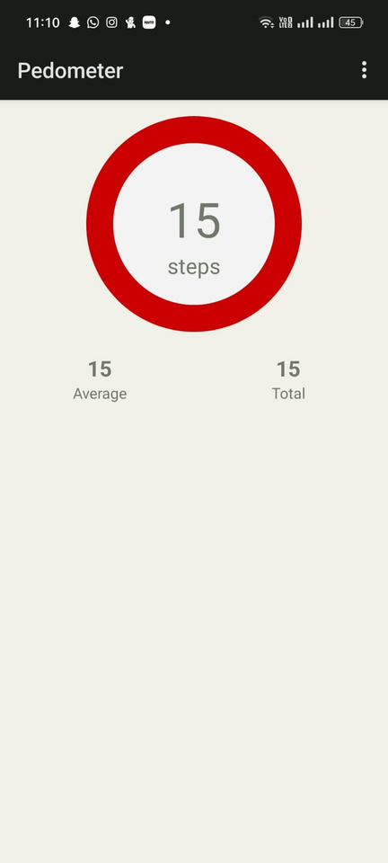

STEP TRACKER APP: YOUR PATH TO A HEALTHIER YOU
YOUR STEPS MATTER, AND SO DOES YOUR HEALTH DATA. SYNC THE APP SEAMLESSLY WITH OUR HEALTHCARE WEBSITE TO PROVIDE YOUR HEALTHCARE PROFESSIONALS WITH VALUABLE INSIGHTS INTO YOUR PHYSICAL ACTIVITY.
EMBARK ON A JOURNEY TO WELLNESS WITH OUR INNOVATIVE STEP TRACKER APP SEAMLESSLY LINKED TO OUR HEALTHCARE WEBSITE. THIS USER-FRIENDLY APP GOES BEYOND COUNTING STEPS; IT'S A HOLISTIC APPROACH TO PERSONAL HEALTH.

Slide 7
VIDEO CALL WITH DOCTOR
IN OUR HEALTHCARE WEBSITE'S QUEST TO PROVIDE COMPREHENSIVE CARE, THE VIDEO CALL WITH DOCTOR FEATURE EMERGES AS A TRANSFORMATIVE BRIDGE BETWEEN PATIENTS AND HEALTHCARE PROFESSIONALS.
REAL-TIME INTERACTION:
VISUAL SYMPTOM ASSESSMENT
PRIVACY
SOMETIMES WORDS ARE NOT ENOUGH. WITH VIDEO CALLS, DOCTORS CAN VISUALLY ASSESS SYMPTOMS, PROVIDING A MORE ACCURATE DIAGNOSIS AND PERSONALIZED RECOMMENDATIONS BASED ON A COMPREHENSIVE UNDERSTANDING OF THE PATIENT'S CONDITION.
YOUR HEALTH DATA IS PRECIOUS, AND WE TREAT IT WITH THE UTMOST CARE. THE VIDEO CALL FEATURE SECURELY TRANSMITS YOUR HEALTH INFORMATION, ADHERING TO STRINGENT DATA PROTECTION STANDARDS. YOUR MEDICAL HISTORY STAYS BETWEEN YOU AND YOUR DOCTOR, ENSURING CONFIDENTIALITY.
EXPERIENCE THE IMMEDIACY OF HEALTHCARE. PATIENTS CAN ENGAGE IN REAL-TIME CONVERSATIONS WITH DOCTORS, DISCUSSING SYMPTOMS, TREATMENT PLANS, AND SEEKING ADVICE WITHOUT THE NEED FOR PHYSICAL APPOINTMENTS.

Slide 8

Security is not a choice; it's a necessity in every digital step we take.
AWS SERVER SIDE ENCRYPTION
DECENTALISED BLOCKCHAIN
IP WHITELISTING
AWS PROVIDES RESOURCES TO HELP PROTECT CRITICAL SYSTEMS AND SENSITIVE DATA AGAINST RANSOMWARE.
These resources assist in preparing an organization .
UTILIZING BLOCKCHAIN ENSURES A DECENTRALIZED, TAMPER-PROOF LEDGER.
THESE CONTRACTS AUTONOMOUSLY ENFORCE SECURITY PROTOCOLS, REDUCING RELIANCE ON CENTRALIZED AUTHORITIES AND ENHANCING OVERALL SYSTEM INTEGRITY.
. BY RESTRICTING ACCESS TO APPROVED IP ADDRESSES, WE ENSURE THAT ONLY TRUSTED ENTITIES CAN INTERACT WITH OUR SYSTEM.

Slide 9
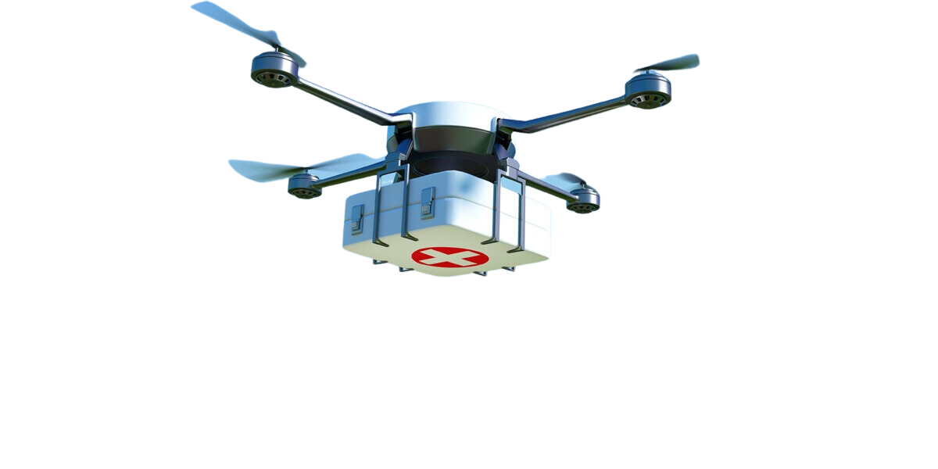
FUTURE OUTLOOK: ELEVATING HEALTHCARE THROUGH DRONE DELIVERY
Imagine a healthcare website that transcends boundaries, literally. Our vision for the future involves a seamless integration of drone mechanisms for the swift and precise delivery of medicines and health-related essentials.

Slide 10
Thank You

